Slide 1
DEVELOP AN OUTCOME L2
Evidence of Learning Template
18481
Hangman Game
Hangman DT Internal

Slide 2
Github /Drive link
Trello board or PM link
You MUST provide evidence showing how the problem has been decomposed, how the components have been developed and trialled, and of how they have been assembled and tested to create a final, working outcome.

Slide 3
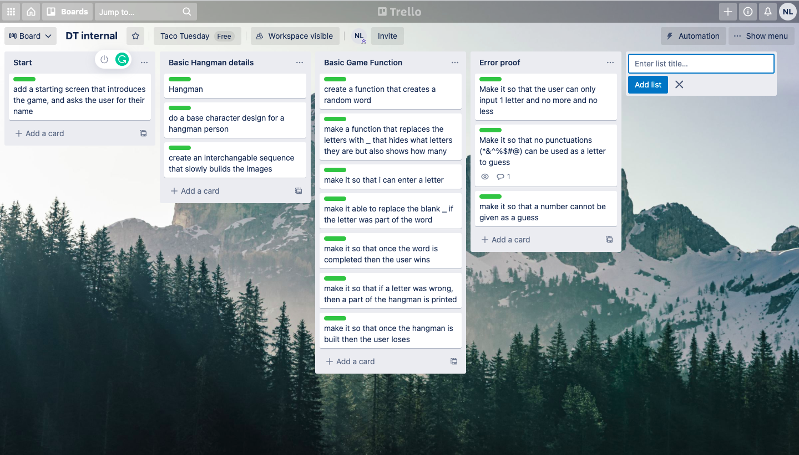
Project management: Setup
Record evidence that you have setup project management tools to manage the development of your outcome.
For my project Management tool I decided to use Trello and make a Trello board to manage my project. I did this because of many reasons:
In Trello I found that adding tags for things I have to do was really easy for me to read and understand exactly where i'm at in terms of how developed my program is, and once I had completed a step indicated on the board I was able to highlight it with a green label afterwards to indicate that that particular step in my code has been completed.
https://trello.com/invite/b/rt4Za6uv/90af7db86a6e14e27f73b3441d367cf7/dt-internal - This is the link to my Trello board that i used to manage my project creation
Notes:
Planning: comparing two project planning tools. Start the paragraph with time target [more than 10 weeks], Milestones, collaboration - sharing on different devices.
Choose from To Do list, decomposition, mind map. Task sizing graph

Slide 4
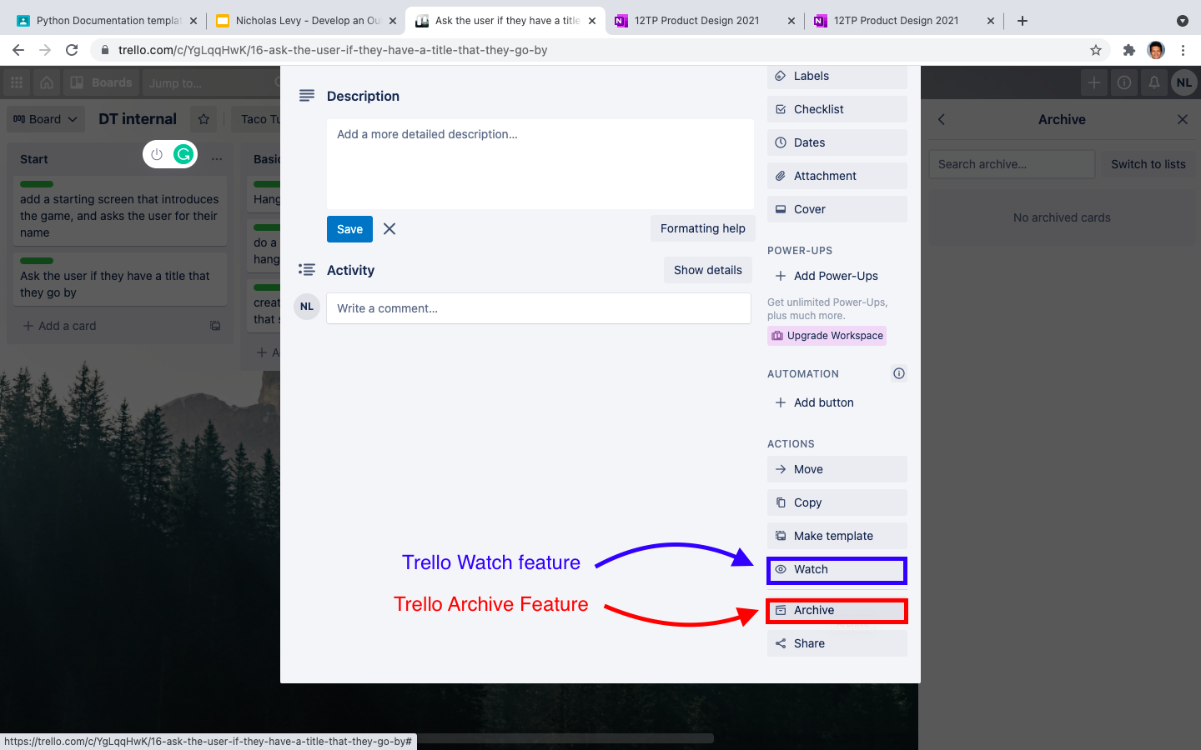
Project management: Setup
Record evidence that you have chosen project management techniques to manage the development of your outcome.
Techniques that I found useful when using Trello was its ability to save the history of everything I did on my work board. This allowed any changes done to be saved and I wouldn't have to worry about any work being lost while planning.
Another project management technique that I found useful was the watch feature, which added an eye under the tag / step meaning that currently it isn't suitable to complete at the moment and that i should leave it for later or when i am done with whatever is more important, and finish if i had time.
The Archive feature was also a handy technique that allowed me to put away some difficult components that I didn't have enough time to complete, or components that I found to obsolete in regards to its need to be in the outcome. Of course if at a later time i realise that it would be nice to have or if a user gives feedback on actually adding the component (Which would better the final outcome) I could just go to my archives and restore it to put it back on the planning board.
The Iterative techniques used through the process of creating the hangman game however mainly used the Agile method as composed to the waterfall method because the waterfall method was mainly a linear technique while Agile was more flexible if I wanted to change anything or a issue or problem arose. I also personally found that the Agile method was more suitable and helped me better in my creative process then the Waterfall method.
Notes:
USE the words Iterative processes.
compare an Agile method/technique and the waterfall method/technique

Slide 5
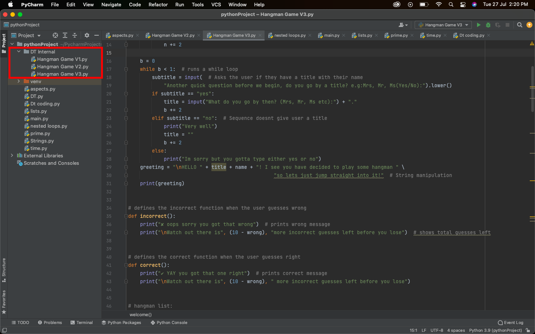
Project management: Setup
Record evidence that you have setup/ chosen version control tools/techniques to manage the development of your outcome.
Here you can see the use of 3 different versions of my hangman game.
The first composed of a basic layout and code for it to work.
The second is a more advanced and thoughtful version that incorporates different functions from the basic version.
The third and final version is a more refined version of the 2nd one that fixes possible errors that could break the code and stop the game. Finishing it as my most refined version of the code.
Also to ensure that all my files were saved I used pycharm where it the Pycharm version control automatically saves the work done in case of an error or issue that may come up while coding, and will ensure that the code is not lost or gone.
Notes:
How we saved files. Used GitHub
File saving conventions
Pycharm version control. - pycharm automatically saves the code.

Slide 6
Project management: Setup
Explain why you believe that these tools and techniques are appropriate for the development of your outcome.
Setting up the Trello board as shown on the left, to me, was very effective to keep my work organized. Starting from the left where the beginning steps lead into the bigger more complex steps really helped me to see which parts i could work on and complete and modify. Marking the tab with a green label also helped me to see clearly which tasks were already completed and the archive feature helped me to bury any false or not as good components towards the archive bin but can also restore later if I found that I had the time and abilities to complete the task.
Trello also is easily able to share and collaborate with others with the invite feature at the top that allows for others to come view and modify the board in case I need fellow support.
I also employed Agile methodology following the Plan - Design - Develop - Test - Release - and Feedback looping back into plan.
Notes:
Sharing, collaboration
Agile or waterfall method
Scrum and sprints

Slide 7
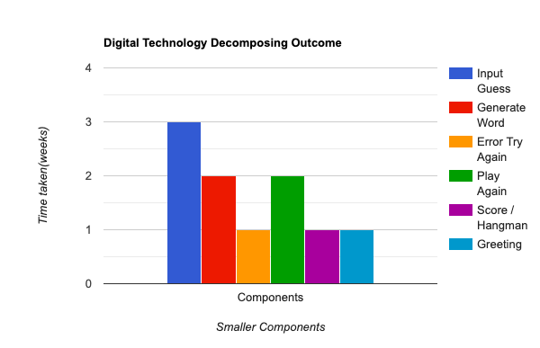
Decomposing Outcome
Record evidence that you have broken the outcome into smaller components.
As shown on the right, the bar graph shows about how many weeks I spent on the different aspects of my digital outcome out of the total 10 weeks we had to make it. Mainly broken up into 6 main parts of the out come, I had the Input guess, Generate word, Error Try again, Play again, Score/Hangman, and Greeting, which were the main components of my game. All of these components had their reasons for the amount of time spent on them out of the 10 weeks, such as the issue I found with when the user guesses all the correct letters for the word and therefore allowing them to win the game. This took a long time to figure out as I had to solve issues such as when the word has two of the same letters and how to put them in the right order for the code to recognise that the word has been guessed.

Slide 8
Decomposing Outcome
Decomposing the outcome was, as said previously, by using Trello board as a sort of online to do list that marked out the different components needed and which part I am up to. It was really helpful in separating the beginning, middle and end stages of the project and also to help breaking the main components down into its smaller parts. Such as the start which begins on the introduction; and the basic hangman parts that starts the design and look of the hangman that also leads into the score components and et cetera.

Slide 9
Trialling components
Record evidence that you have trialled components. Show that you gathered information to inform your decision making.
Record evidence that you have trialled multiple components and have selected those most suitable.
Record evidence that you have used information from trialling appropriately to improve the functionality of the outcome.
Notes:
Must do four trials.
Trialling is about making a code more efficient by lessening the space the code takes up.
Ms expects that each trial will take up to 2-3 slides each, so about 8-12 slides in total.
Before and after, proof of why you changed it. Only wants 4 of the best ones.
Techniques include:
Comparing alternatives - before/After
Addressing implications
Stakeholder feedback

Slide 10
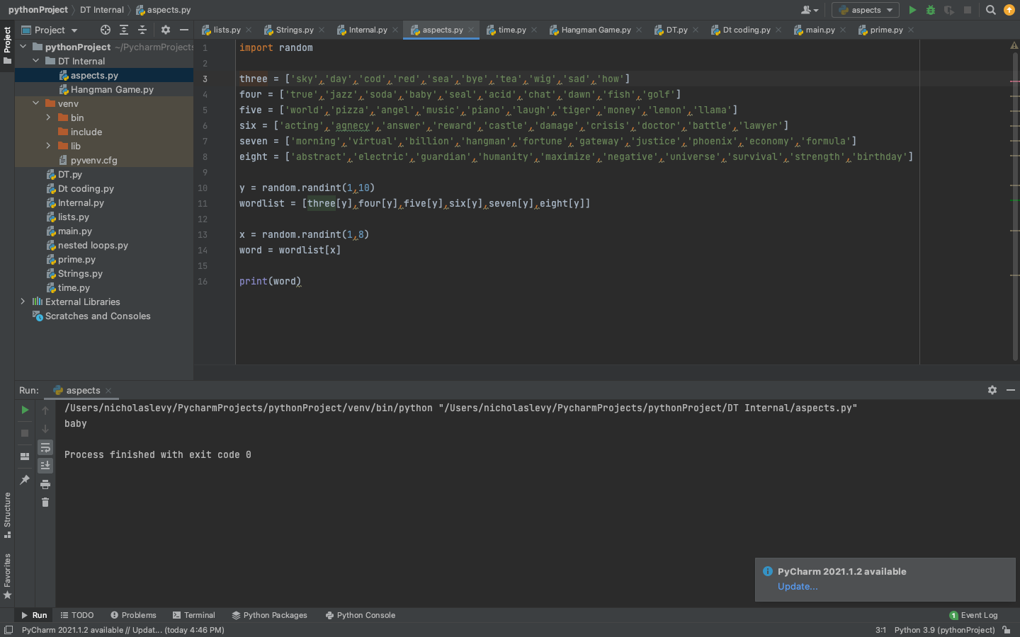
Trialling components, Word component:
The word component for my hangman game is probably the second most crucial component to the game as it is the goal that the user has to aim for.
Here on the right is an image of my first attempt at creating the word component, where I created 6 lists from numbers 3 - 8 with ten words in each with amounts of letters corresponding to the number of the list e.g three [sky, red, bad etc].
Then i would put all the lists into another list named ‘wordlist’ and use a random module to create a random number between 1 and 10 to act as a ‘y’ variable to choose from the ten words in the list and use the random module again for an ‘x’ variable that randomly sets which amount of letters the word should have.

Slide 11
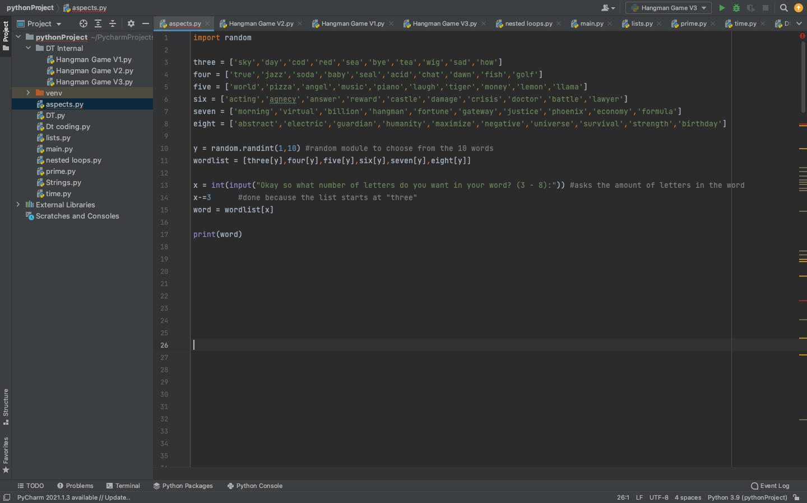
Trialling components, Word component:
However as part of my planning, I stated that I would give the user the option to select the amount of letters they want in their word. So instead of having another random module to randomly choose from the list, instead I changed it so that the ‘x’ variable that decides how many letters in the word there should be, will be an user input, allowing them to decide however many letters they want from 3-8 letters. I then minused 3 from it as ‘three’ would actually be the first in the list and so the ‘x’ variable would need to be a 0, or if the user wanted 6 letters and typed ‘6’, the six in the list would need to be 3 to correspond to the right amount, hence why after asking the user to input how many letters they want in the word as ‘x’, the next line down I have x-=3.

Slide 12
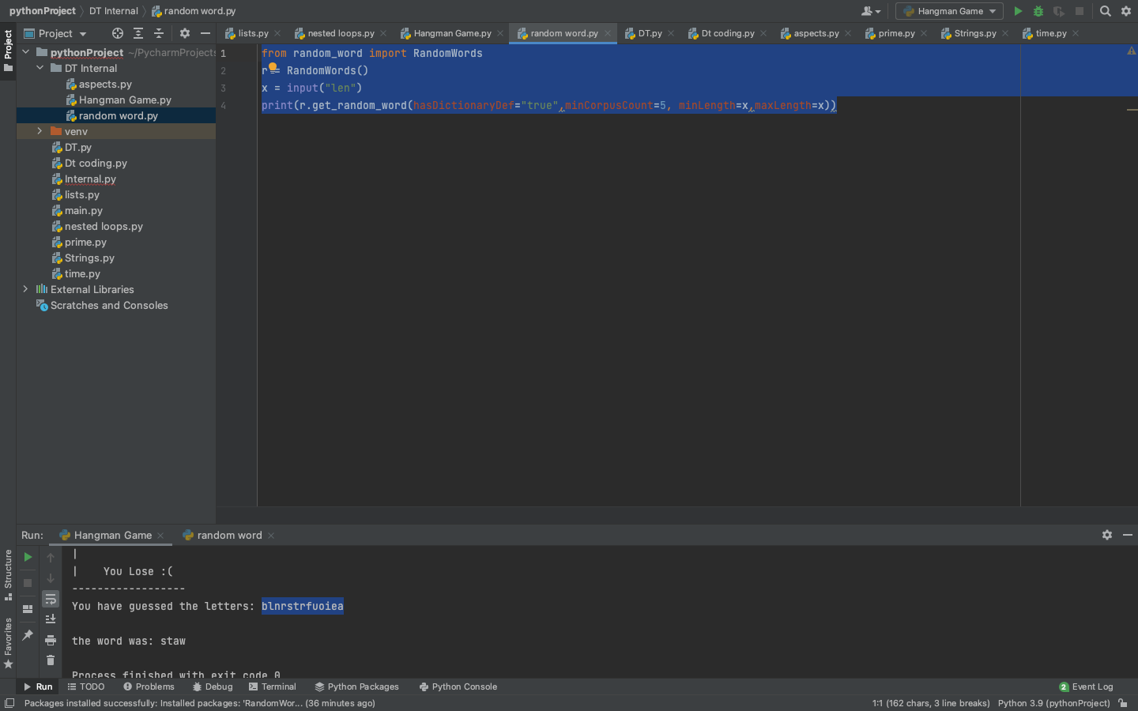
Trialling components, Word component:
Working on this however I realised that there were restrictions with what I had previously: mainly with the issue that there were only 10 words in each list for a total of 80 words all together, which makes the issue that there was a chance that words would repeat frequently and severely make the game less fun, as users have already got this word before and can just infer it after 1 or 2 letters. To deal with this issue I changed the code and instead used an external library known as ‘random_word’ where it imports a random word.
To make sure the word was an actual real word I had HasDictionaryDef = True and I had the CorpusCount = 5 where the CorpusCount was a representative for how often the word is used, so a ‘5’ value means that it isn’t an obscure word that no one has heard of but also has some hard and difficult words mixed into the lot.
And to make sure the user could select the length of the word I had the minLength and maxLength = x, where ‘x’ was the input variable that asks how many letters the user wants in there word.

Slide 13
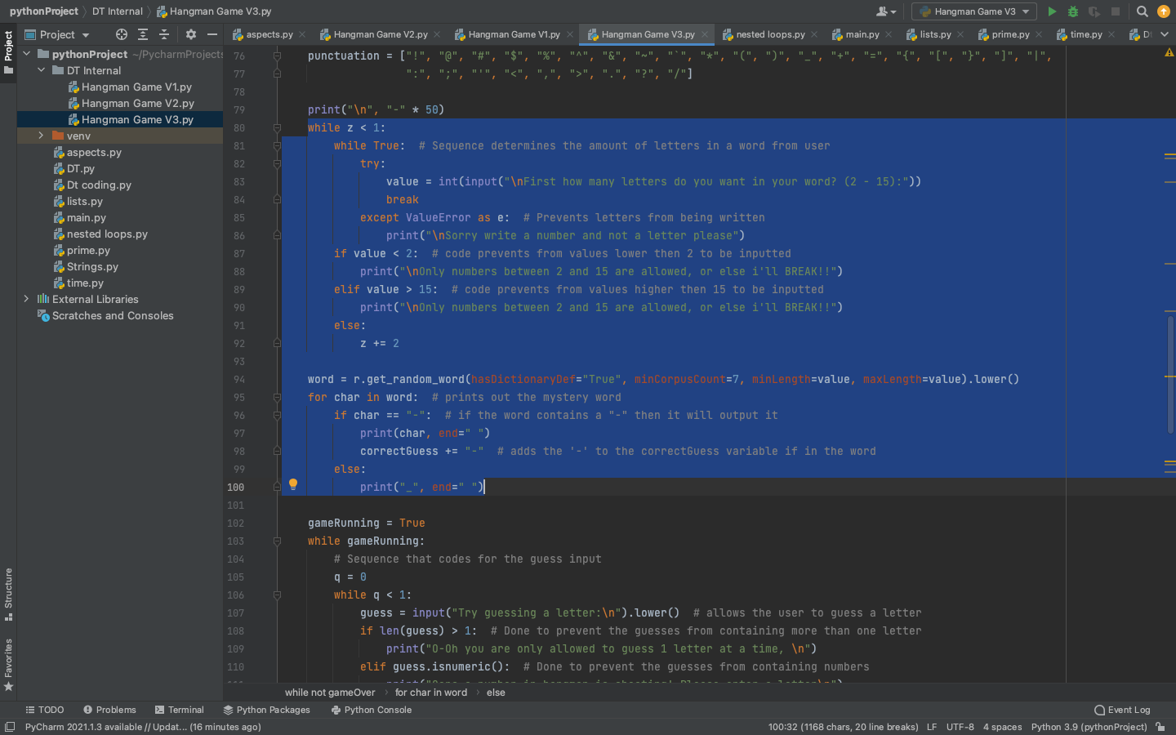
Trialling components, Word component:
Finally, to refine the word component, I trialled the code with some family members and friends; where they said that words with letters over 15 were just redundant and not as fun as the more concise words with less than 15 words. So I made sure to change it by adding restriction when the user inputs ‘x’ such as it being a value between 2 and 15 because if the user were to input ‘1’ then it would grab a random amount of letters for the word. I thought about using this as a feature such as saying “If you want a random amount of letters to be chosen input 1” but eventually decided against it after asking people who tried it.
I also debugged it so that if someone were to input for the amount of letters in the word, that it cannot be a word or a punctuation mark such as: !@#$%^&*(), and only a number would be accepted.
And to address the functionality implication to make sure that the outcome will do what it is supposed to, I put in error messages for each of the fixes stated above so that if the user should accidentally do any of these, then it will not work and ask the user to input an acceptable input that follows the error message such as it being between 2 and 15, not being a punctuation, and it being a number and not a word or letter.

Slide 14
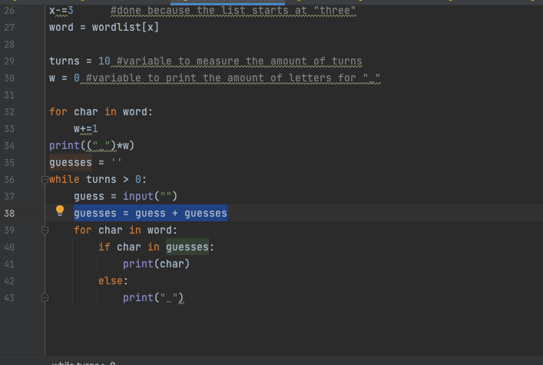
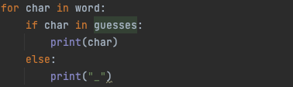
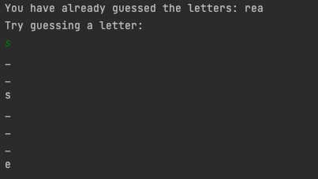
Trialling components, Guessing component:
While the word component can be said to be the second most important component of the outcome, the Guessing component would be the first. Starting out the the component I used an input for ‘guess’ and later have ‘guesses = guess + guesses’ effectively storing all the guesses that the user has input into the game. As shown by the imagery the right ----------->
To show the user which letters of the word they have filled out I have this code:
Where for each of the characters in the word; if the character is in ‘guesses’ then it will print the word, else it will just print an ‘_” which shows to the user that the letter hasn't been guessed yet.
Of course a problem later showed up with this approach where the word with the guesses would be shown going down vertically with each on its own line as shown on the right here:
Continue to next slide ---->

Slide 15
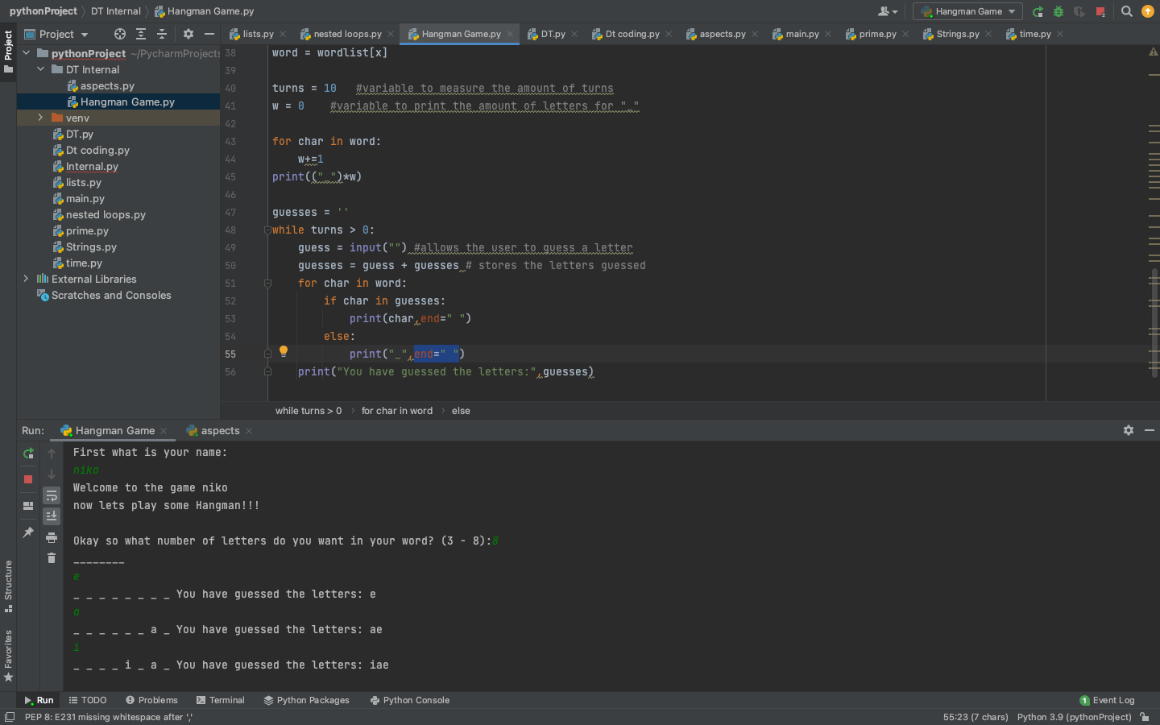
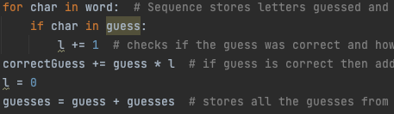
Trialling components, Guessing component:
To fix this issue, within the print(char), i added an: ,end=” ” to append the string at the end of the output of the print statement in python. Doing this i found immediately fixed the problem as shown below:
Of course the purpose of the Guess component of the game was to guess the word and win the game, and it was because of this fact that it took the most time to complete out of the other components. This was due to me trying to figure out ways of letting the game code to recognise that the user has won which came with some difficulties.
To do so however I created a separate variable called Correct guess, and to account for there being multiple of the same letter in one word I used if char in guess: l += 1 then used correctGuess += guess * l, which solved that issue and also set l to = 0 afterwards to reset it. To also make sure that the guess and word match up and for the game to recognise that, i made it so that if sorted(correctGuess) = sorted(word): then the user would win solving the issue on how the game would recognise that the user has fully guessed the word

Slide 16
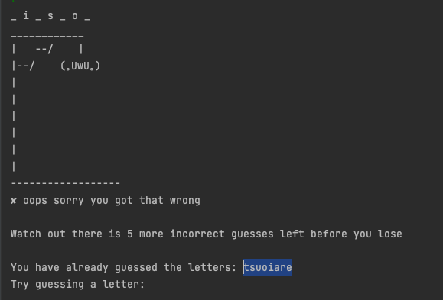
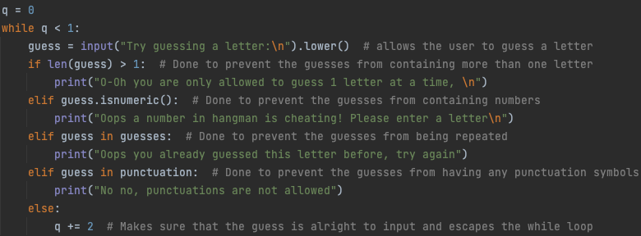
Trialling components, Guessing component:
When trialing on some of my friends and family, they told me that it was a bit annoying that they weren't able to see which letters they have already guessed, so fixing this issue I used this line of code:
print("\nYou have already guessed the letters:", guesses)
By doing this a small line will appear after the user makes a guess and shows which letters they have already guessed. Further helping them with which letters they are allowed to input and which they aren’t (They can’t input the same letter twice)
Finally to finish off the Guessing component I again debugged any unacceptable inputs for the guessing and added error messages for each like with the word component, addressing the functionality implication again with error messages that explain the problem and ask the user to try again.

Slide 17
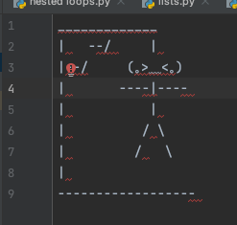
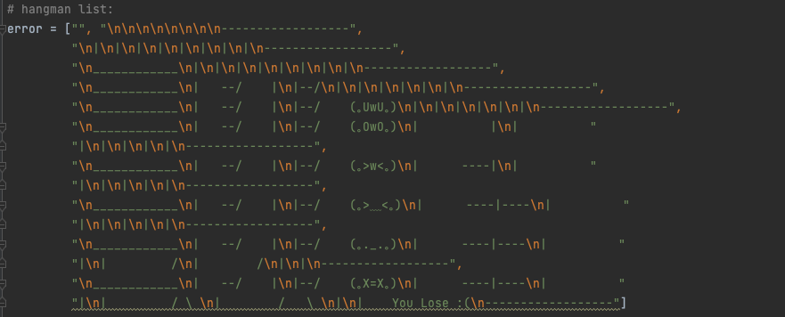
Trialling components, Score component:
To clarify what the score component is for my hangman game, it involves the hangman model and how it slowly builds up as the user inputs incorrect guesses and eventually loses once all of the hangman is built up (10 chances to get it wrong before the user loses).
I then later organised the hangman into an entire list as it slowly builds up, and to address slightly an implication such as aesthetics by asking friends if they could tell that it was a hangman, and by adding cute and cool different faces for the hangman such as: (.>_<.)(.UwU.)(.OwO.)(.>w<.)(.X=X.)
Which I as well as my friends who tested it, thought was cool and a nice touch.
Here is an image of the full hangman. Done when I first started on this project

Slide 18
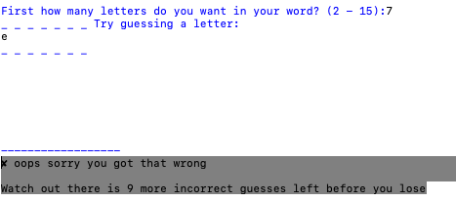
Trialling components, Score component:
To also address some of the functionality implication, sometimes it may not be clear to the user how many guesses they have left when looking purely off of the hangman and so to help clarify this I added a small message at the bottom of the hangman game saying that they guessed wrong and exactly how many guesses they have left until they lose.

Slide 19
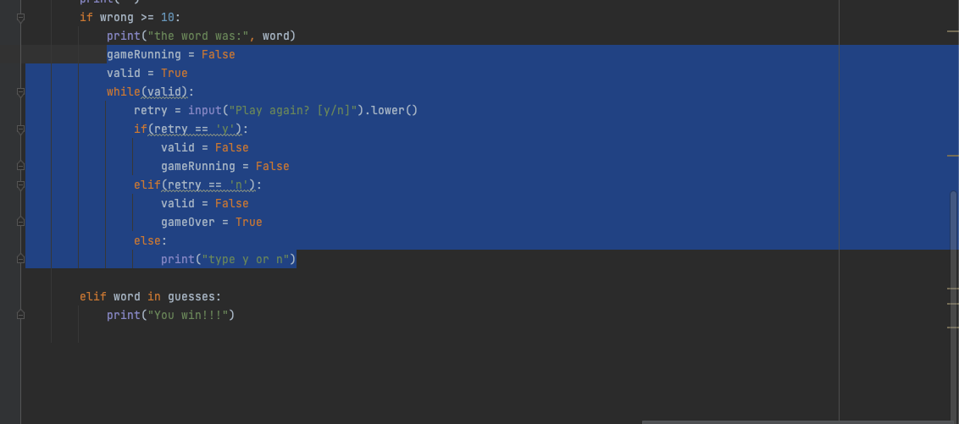
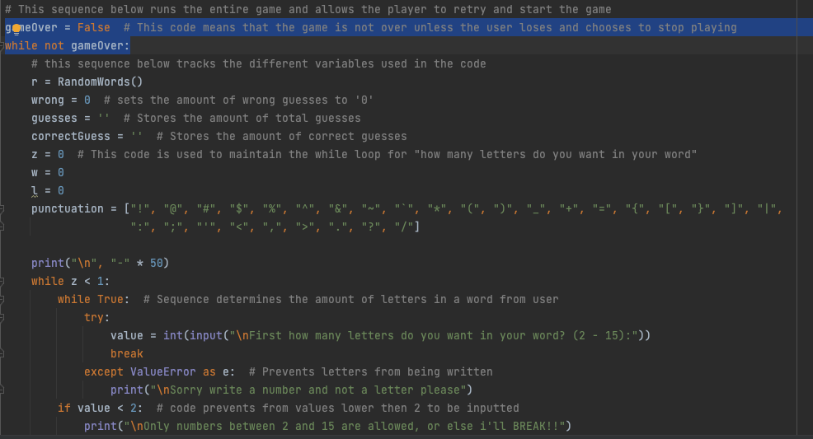
Trialling components, play again component:
The Play again component at the end of the game that appears whether the user wins or loses the game, I would say, is an important part of the game that allows the game to continue and makes so that the user wouldn't have to reload the program again and go through the beginning questions such as their name and such again and can just go straight into the game again to either redeem a loss or gain another win.
Because of this, the hangman game was split into two parts, being GameRunning and GameOver. The GameOver part of the code incorporated the whole game, minus the greeting, within a while loop where the game will run as long as GameOver = False and GameRunning which only incorporated the guessing part of the code and will run as long as GameRunning = True, this was done because I only wanted the Intro to appear at the start, and only have the ‘select how many letters you want in your word’ to appear at the start of a new round after the

Slide 20
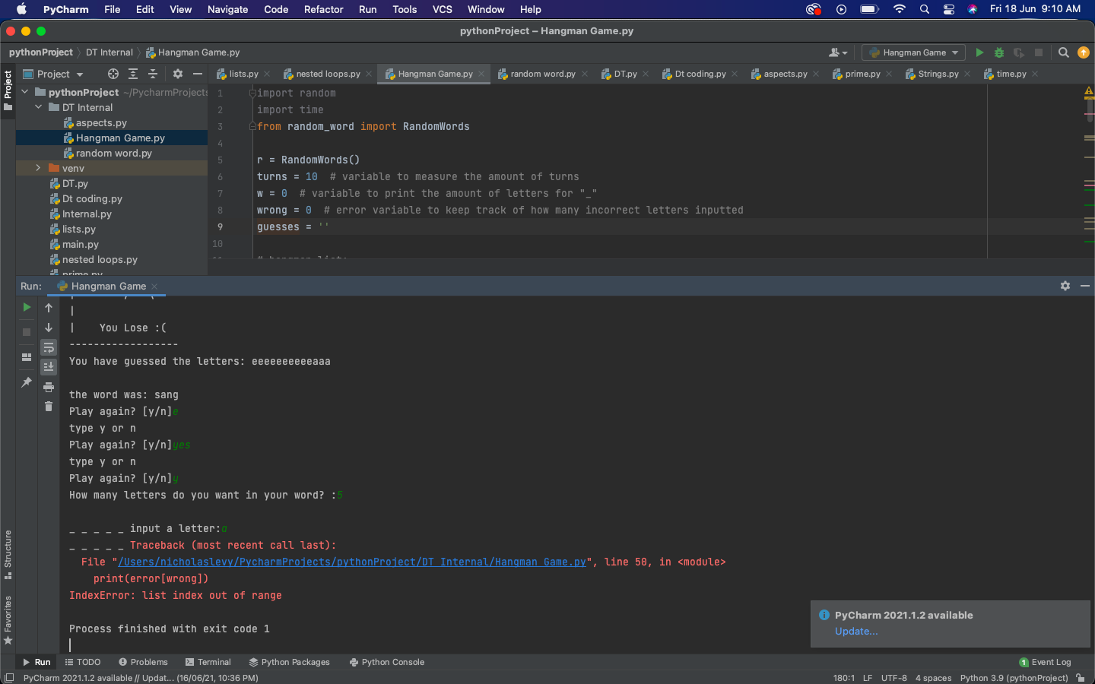
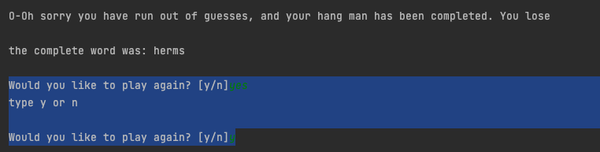
Trialling components, play again component:
A small problem that came up while trialling the play again component was that if the user were to get a letter wrong on the second time, an index error would appear stopping and breaking the game. To fix this, I had an section of code for all the variables such as ‘guess,wrong’ and letter variables which used to be at the very top of the code but not within the GameOver while loop, so I just had to move them within the while loop to reset them again once the game resets so that the index error wouldn’t appear again.
To also once again address a small functionality implication there was also an error message telling the user to type either y or n at the end asking if they would like to play again, and if they type anything other than y or n the game will tell the user so and again repeat that they should only type either y or n, helping the user understand what they have to do.

Slide 21
Testing outcome
Record evidence that you have tested your outcome.
Explain how the testing made sure your outcome functions as intended to meet its purpose and requirements.
Record evidence that you have used information from testing appropriately to improve the functionality of the outcome.
Notes:
Testing:
Debugging: Debugging means finding and fixing problems in your code. As you write your code you will run it frequently and fix any problems that you discover.
Code validation: If you are making web based outcomes you need to make sure your code validates. Online code validators check that the syntax of your HTML and CSS files follow the rules of the language and meet current conventions.
Testing tables
Stakeholder feedback:
Usability testing:
Evaluating against requirements:
Evaluating against relevant implications:
Final testing of the code

Slide 22
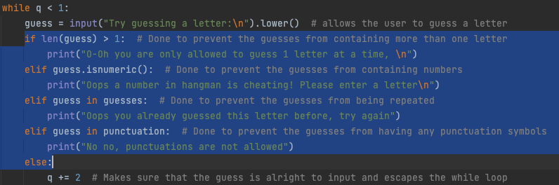
Testing Debugging
Addressing implications such as Usability where I help users to do what's intended and Functionality where I debug some errors in the code so that the user does not break my code, the Error try again component of my outcome became really important. Testing it myself as well as give my friends a try I quickly found some restrictions i needed to add to the guess component such as it could not be a number, cannot be a letter guessed previously, can only be one letter and not more, and not a punctuation. So to fix these restrictions for the guess component I did so as shown on the right: where the guess input won’t be accepted if it is any one of the problems stated above.
I also did similar tests for other components such as the word component as shown by the image on the right where it has to be a number, and only values between 2 - 15 would be accepted because above fifteen after testing on other users said that sometimes a word wouldn’t load and some of them were obscure words that they have never heard of. So to improve user experience I restricted the letters to not exceed 15 which users said was much better.

Slide 23
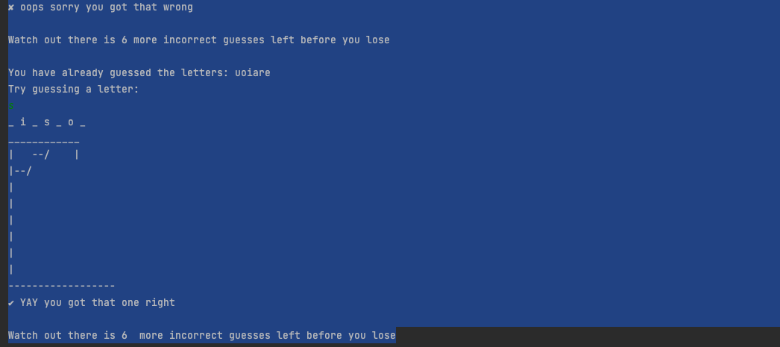
Testing Outcome
From testing with my friends, one of them gave a cool idea to give the hangmen different faces as they get built from the different stages such as (.>_<.)(.UwU.)(.OwO.)(.>w<.)(.X=X.)
Which I as well as others that tested it after thought was pretty cool.
Also after testing the hangman game on some of my family one of them said that some error replies felt too robotic such as ‘cannot input a number, please only input a letter’ etc. so to fix this I went through the replies and tried to make the replies more interactive and human-like as shown by the image on the right, where that same family member said that it was much better.

Slide 24
Testing Outcome
As said in the trialling section but also part of the testing, was the change in the code for the word component:
At the start I first used 6 lists of words with different numbers of letters in each along with a random module that randomly picked from the words within the list. At first I thought that it was an effective approach for its purpose, however after some consideration and testing from friends who frequently encountered repeated words, I opted to find a different solution which lead me to using an external library random_word, and made sure that hadDictionaryDef=True which means that it is a real word and not an obscure made up word and also that the minCorpusCount=5 which shows how frequently the word is used to make sure that the word is a relatively commonly used word with the minimum and maximum length set to ‘x’ which is an input variable taht the user can input to select the length of the word. And after testing it with users after the change, it became clear that the game and code improved significantly from before.

Slide 25
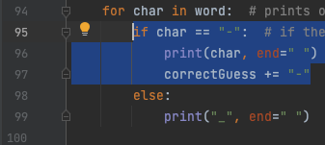

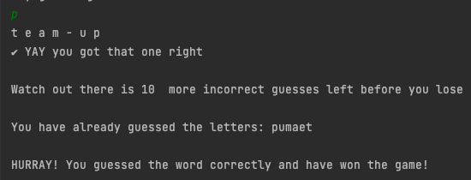
Testing outcome
While testing the outcome with some of my friends as users I was surprised to find that within the external library of random words, some of such words would contain a ‘-’ that connects some of them which makes sense as some words do indeed have that sign. The problem arose however because one restriction placed on the guess component was that users could not use punctuation so I couldn't just reject the use of other punctuation but accept that one as that would seem unfair to the user who has limited turns and letters to input. So to solve this i still restricted the use of punctuation within guessing but rewrote the code so that if there were a ‘-’ detected within the word instead of appearing as a blank space for the user to guess (_) the code will just automatically add it straight away and add it to the correctGuess variable so that it doesn't affect the user from losing and later tested it again by manually changing the word to ‘team-up’ and as shown by the two bottom right screenshots, shows that the code would now work fine with the addition of the ‘-’ further strengthening and improving the code.

Slide 26
Project management: Applied
Record evidence that you have used your project management tools to manage the development of your outcome.
Record evidence that you have used your project management techniques to manage the development of your outcome.
Record evidence that you have used version control tools to manage the development of your outcome.

Slide 27
Project Management tools
As stated at the start I mainly used Trello to organise and plan out my designing and coding process for my hangman game. It was useful as it was easy to see which stage of the planning process I was up too and what components or functions I needed to start thinking about or how I should implement them into the game. Other features such as archive, watch, and tagging sections with colors to indicate them being done really made it easier for me to understand the general direction that my code and process was going in.

Slide 28
Project Management techniques
The main project management technique utilised throughout my coding process was using Agile methodology as a process for creating the game. Using this methodology was helpful as it is a repeated and iterative process that allowed easy and effective changes to be made within the code. An example of me using Agile techniques was when I was coding the word component, the requirement of which was that the users could choose an amount of letters long that the word has to be and a random word of that length will generate for the user to guess. With these requirements I went through design and development where I created my first version of the word component which I already explained about in a previous slide section, but then from testing and feedback where users would get words that repeat a few times, I found that a better alternative was to utilise an external library and just modify the restraints so that users could still choose how long they want their words that they guess to be.

Slide 29
Project Management Version control
Version control was important and useful to me because over a few times in version 2 while I was debugging some errors and issues with the code to strengthen it, there were a few times where the changes made to the code would cause errors that stop the game from working all together rather than fixing it, and a solution to these errors was found with reference to the first basic version 1. Using some of the code from version one I was able to fix and rebuild the code to what it was supposed to be and was able to improve the game as a whole without affecting other components from running either. In regards to version control as well, Pycharm had a very helpful function of automatically saving all code done so that I would not have to worry about losing work progress.

Slide 30
Version Control
Your version control evidence should go here. This could be in the form of annotated screenshots which show you you managed this process or you could make a brief screencast explaining how you implemented version control.

Slide 31
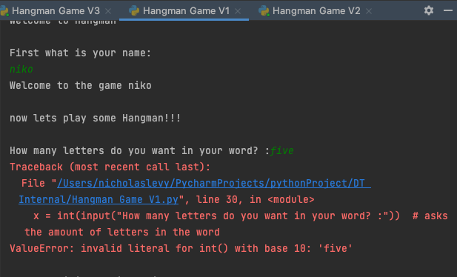
Version Control
As shown by the right image, I demonstrated the use of version control through 3 different versions of the hangman game. These versions were improved versions of the ones before them with version 3 being the most refined version out of the lot. Version 1 (V1) utilised the basic functions of the game but had a lot of debugging and improvements needed to be done such as input errors where if a user types in a word instead of a number when the code asks how much letters they want in their word, immediately the game would break and stop functioning. Errors such as these were apparent all over version 1 however if the rules were followed upon then the game would function relatively correctly concluding version 1.

Slide 32
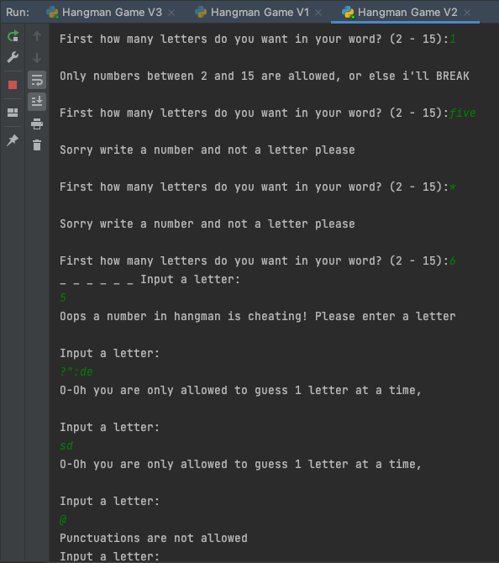
Version control
Version 2 of the hangman game was where I debugged a lot of the errors found from testing the code with my friends. As shown by the image on the right afterwards where I retried these errors and as expected saw the correct error messages telling me what I did wrong. I also changed a lot of the error messages and printed messages to be more human like rather than the robotic tone there was previously as it was a concern that one of the people testing my game raised.

Slide 33
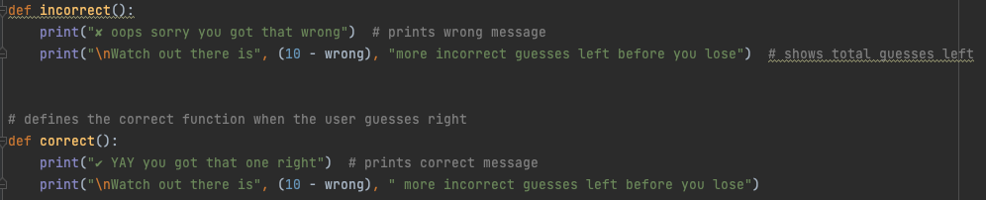
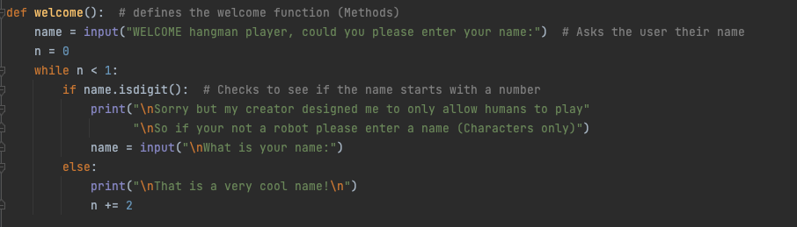
Version control
Version 3 of hangman was the currently most refined version that I coded. Mainly building off the last two, I then refined the code as opposed to the game which I still added a few tweaks too but mainly incorporated efficient use of the code by utilising techniques such as ‘def’ functions.
Version control is an important part of coding as you can never know what might happen, and if an error does occur like it did a few times when I was debugging some errors that eventually stopped my game from working all together, it helped to use the first and basic version of my hangman game as reference to see what might have prompted the game from working as intended and helped to make coding the game more safer and efficient.

Slide 34
Relevant Implications
Explain the relevant implications here. Please watch this video to learn how to do this.
Explain the Implications that are relevant to your outcome.
Record evidence that you have addressed the Implications that are relevant to your outcome.
Notes:
For the Implications. I should do 2 paragraphs, the first one worth
.A. and describes the implication, explaining what the implication means and why it is important, say why its relevant to my outcome
M. Add a section of how I addressed the implications
Only 4 Implications. Minimum and Maximum.

Slide 35
Relevant Implications - Usability
What is Usability?
While designing a digital outcome an essential part is considering what the end users need to do and how to help them do it, this is what usability is, it is the consideration that programmers and designers have to put into creating a game, program, or website to help users achieve the purpose of the code or game and make it easier for them to understand what they need to do.
It is important because, quite frankly, a game where users struggle to figure out how to run or how to actually play the game, unless that is the intended result, will most likely fail to grow popular or have people actually wanting to play it.
I have addressed this usability implication by stating clear error messages if the user were to input an answer incorrectly, these error messages occur for the introduction/Greeting, how many letters in the word, guessing input and if the user would want to play again, clearly telling the user what they typed wrongly and how they should have properly played the game. These error messages address the usability implication because they help the user to play

Slide 36
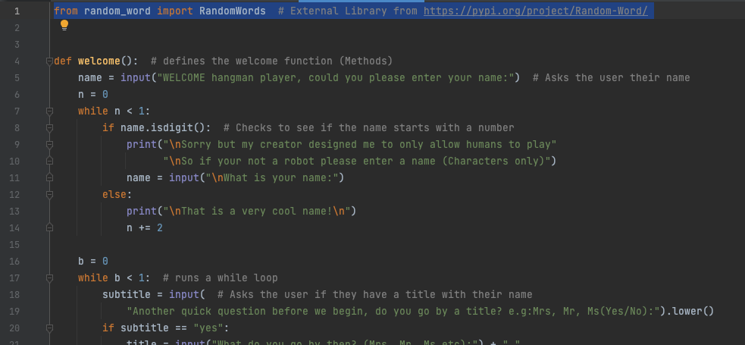
Relevant Implications - Intellectual Property
What is an intellectual property Implication?
Intellectual property refers to the ownership rights of that people have over items, designs, or ideas that they create. With all the different parts programmers use to make up their digital outcome it comes as no surprise that it can come from a variety of places. And if other peoples work were to be used within the digital outcome without their permission, it would be breaching their intellectual property and you could be taken to court and prosecuted which i'm sure no one wants, which is why this implication is so important.
I addressed intellectual property as an implication as throughout the entire process of creating the hangman game I utilised skills and images that I created originally without taking anyone else's code illegally or wrongly. The only bit of code used from an external source was through the external library used to generate a random word, which I credited in the source code as shown on the right.

Slide 37
Relevant Implications - Functionality
What is a Functionality implication?
A Functionality implication is whether the outcome will do what it is supposed to do, and what you can do to make it function as intended. Closely related to usability where it judges the ease of use, functionality will instead judge and verify that the functions of a product or service work as intended.
I addressed the Functionality implication through my second version of the hangman game (Using version control), where I debugged a lot of the errors discovered through asking different users as well as myself to see what I could type to perhaps break the code, or whether the game actually functions completely as intended. Of course as stated previously there were a lot of bugs that were discovered and fixed and many of which were input errors that were later fixed and has an error message that appears informing the user of what they did wrong and what they need to do to actually play the game as intended. Some of the answers of which display the correct answer that the user should input such as at the end when it asks the user if they would like to play again and if they type something random or not correct the game will tell them to either input Y or N as an answer.

Slide 38
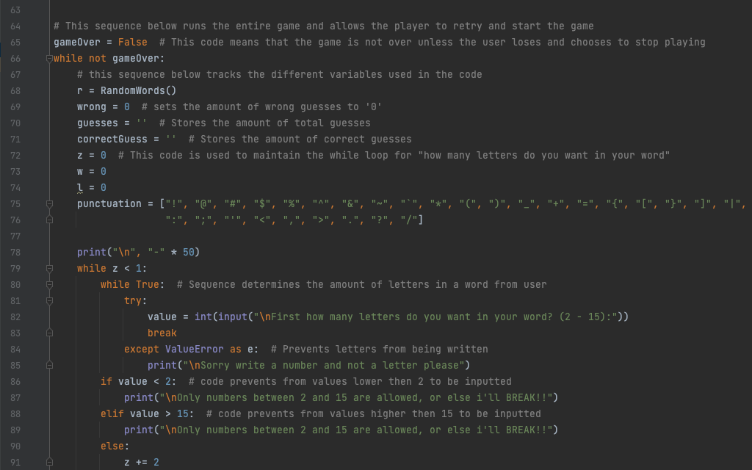
Relevant Implications - Future proofing and Sustainability
What is future proofing and sustainability?
Future proofing and sustainability basically is whether a product, game, or service is able to keep up to date with the changing in times. This can be from whether the code is arranged in a way that allows changes and updates to immediately be found and implemented easily or if the code is commented well which will help other programmers or developers understand and edit the code in the future.
I address the implications of Future proofing and sustainability through the layout of my code which isn't complex and well structured but also through the use of comments on each function that clearly describe its purpose and use. I did so for all parts of the code so that if any part seemed to be out of date or needed some fine tuning, it could be done without much confusion.

Slide 39
Evaluate
Discuss how the information from planning, testing and trialling of components assisted in the development of a high-quality outcome.
Notes:
What you could have done better?
Improvements

Slide 40
Evaluate
In conclusion I used a Trello Board to plan out the different components and tasks needed to complete the game and updated it as I went on by adding some features that I only thought of later. By doing this I was able to clearly see how far I have progressed towards the end goal of finally finishing the game and was able to clearly see which components and features are yet to be finished. Not only did this allow me to not have to worry about whether the game would work well towards the requirements but it also made coding more stress free and a more calm and cool process to go through, and as a result of this I was able to complete a completed piece of work that doesn't break under bugs and function as intended.
I also Trialled my designs towards different age and friend groups to get feedback on any possible improvements that could be made to the game. This allowed me to realise that some aesthetic changes could be done towards some of the design and helped me to design a look and layout that was aesthetically pleasing and worked well for its intended purpose. In total it allowed me to create a game that appeals to the general populous so they will use it more and share it more with their friends.
Testing was also a big part of the digital process that allowed me to find some bugs and errors within the code, an example of this was when a friend tested the code and didnt realise that the last mysterious letter he had to guess was not a letter but instead a dash (-) which I previously did not account for and didn't expect. Realising this, I quickly went back into the source code and modified it so that if another word that has a dash(-) appears it would immediately appear and let the user knows that within their word they are trying to guess there is a dash. Other bugs such as input bugs were also found and by fixing and changing the error/issues I was able to create a strong and reliable code that wouldn’t break no matter what the user would do, and instead the user would be informed through an error message of what they did wrong and what they are supposed to do to continue.

Slide 41
Evaluate - How I could have improved
Of course although I am happy with the final outcome of my code, I still cant help but think when looking back and at my friends code that there was a lot of opportunity that I missed out on. An example of such improvements were maybe improving the GUI of the game, although difficult to pull off and work around I still feel like if I had a little more time to get familiar with the interface and what I could do with it, that I would be able to make a version of a game that was vastly superior to what I have now. Although nothing can be done about it as the code was already submitted and changes wouldn’t matter, with the new found knowledge that I gained along the way I am confident that were I to do a similar assignment to complete that I would be able to complete a game or service that would blow away all previous expectations of myself and surprise not only my friends and family but most importantly myself as I try to push my capabilities to their limits. I still feel like a better GUI would be great for the hangman game as well as use fully inked out drawings of a hangman stick figure, and these features I will be sure to add in my next project, but overall as a person that was diving fresh into the world of python coding I am proud and happy with what I had managed to accomplish with the skills I had at the time.

